Slide 1
Unit-2: Analysis of Algorithm
Analysis and Design of Algorithms (ADA)
GTU # 3150703
Rupesh Vaishnav
Computer Engineering Department
rupesh.vaishnav@darshan.ac.in
9428037452

Slide 2

Outline
Analysis of Algorithm
The efficient algorithm
Average, Best and Worst case analysis
Asymptotic Notations
Analyzing control statement
Loop invariant and the correctness of the algorithm
Sorting Algorithms and analysis: Bubble sort, Selection sort, Insertion sort, Shell sort and Heap sort
Sorting in linear time : Bucket sort, Radix sort and Counting sort
Amortized analysis
Looping

Slide 3
Analysis of Algorithm

Slide 4


Introduction
What is Analysis of an Algorithm?
Analyzing an algorithm means calculating/predicting the resources that the algorithm requires.
Analysis provides theoretical estimation for the required resources of an algorithm to solve a specific computational problem.
Two most important resources are computing time (time complexity) and storage space (space complexity).
Why Analysis is required?
By analyzing some of the candidate algorithms for a problem, the most efficient one can be easily identified.

Slide 5
Efficiency of Algorithm
The efficiency of an algorithm is a measure of the amount of resources consumed in solving a problem of size 𝑛.
An algorithm must be analyzed to determine its resource usage.
Two major computational resources are execution time and memory space.
Memory Space requirement can not be compared directly, so the important resource is computational time required by an algorithm.
To measure the efficiency of an algorithm requires to measure its execution time using any of the following approaches:
Empirical Approach: To run it and measure how much processor time is needed.
Theoretical Approach: Mathematically computing how much time is needed as a function of input size.

Slide 6

How Analysis is Done?
Empirical (posteriori) approach
Theoretical (priori) approach
Programming different competing techniques & running them on various inputs using computer.
Implementation of different techniques may be difficult.
The same hardware and software environments must be used for comparing two algorithms.
Results may not be indicative of the running time on other inputs not included in the experiment.
Determining mathematically the resources needed by each algorithm.
Uses the algorithm instead of an implementation.
The speed of an algorithm can be determined independent of the hardware/software environment.
Characterizes running time as a function of the input size $n,$ considers all possible values.

Slide 7
Time Complexity
Time complexity of an algorithm quantifies the amount of time taken by an algorithm to run as a function of the length of the input.
Running time of an algorithm depends upon,
Input Size
Nature of Input
Generally time grows with the size of input, for example, sorting 100 numbers will take less time than sorting of 10,000 numbers.
So, running time of an algorithm is usually measured as a function of input size.
Instead of measuring actual time required in executing each statement in the code, we consider how many times each statement is executed.
So, in theoretical computation of time complexity, running time is measured in terms of number of steps/primitive operations performed.

Slide 8
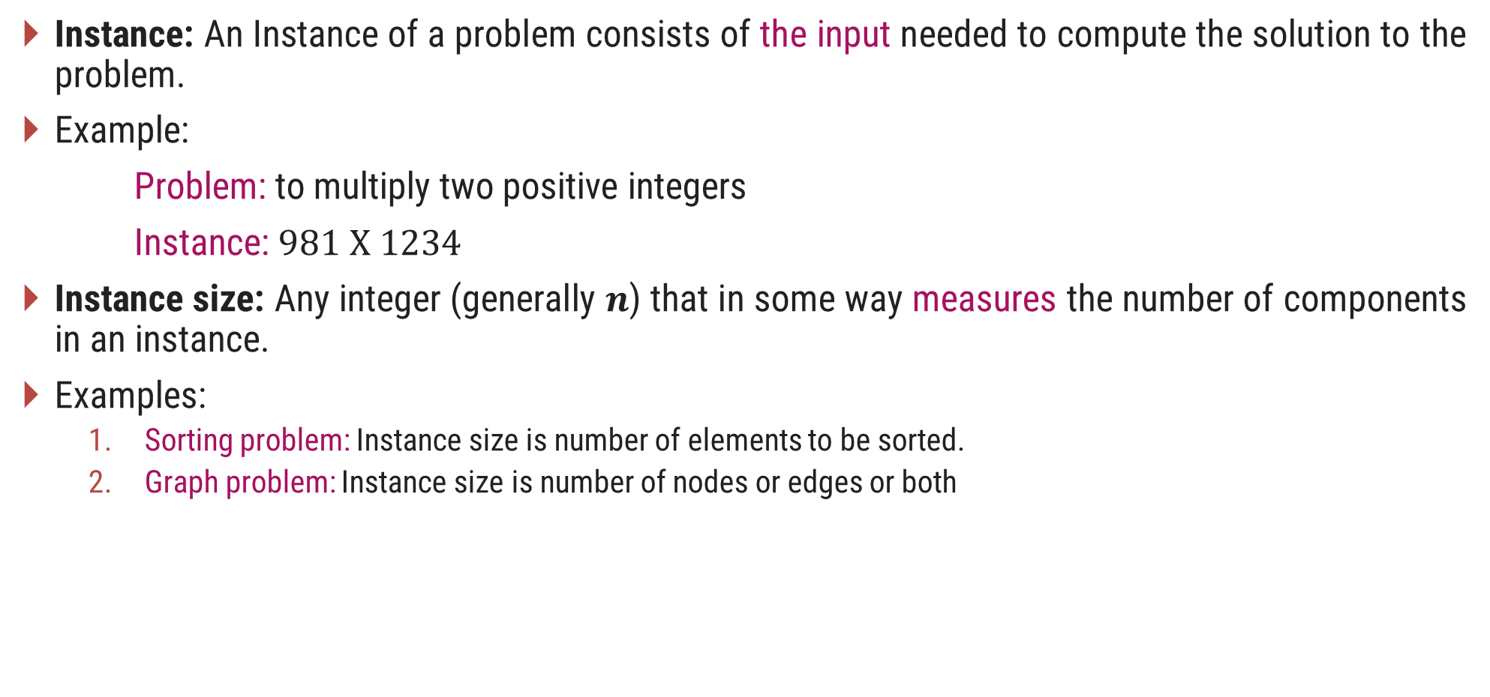
Problem & Instance
Instance: An Instance of a problem consists of the input needed to compute the solution to the problem.
Example:
Problem: to multiply two positive integers
Instance: $981 X 1234$
Instance size: Any integer (generally 𝒏) that in some way measures the number of components in an instance.
Examples:
Sorting problem: Instance size is number of elements to be sorted.
Graph problem: Instance size is number of nodes or edges or both

Slide 9

Linear Search
Suppose, you are given a jar containing some business cards.
You are asked to determine whether the name “Bill Gates" is in the jar.
To do this, you decide to simply go through all the cards one by one.
How long this takes?
Can be determined by how many cards are in the jar, i.e., Size of Input.
Linear search is a method for finding a particular value from the given list.
The algorithm checks each element, one at a time and in sequence, until the desired element is found.
Linear search is the simplest search algorithm.
It is a special case of brute-force search.

Slide 10

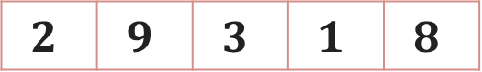
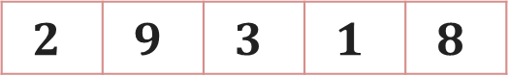
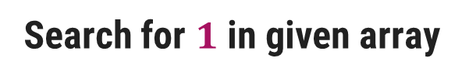
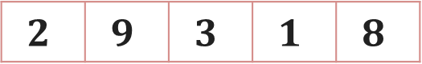
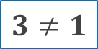
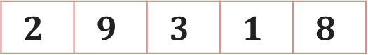
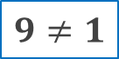
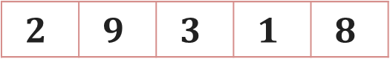
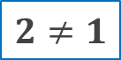
Linear Search – Example
Search for $1$ in given array
$$2$$ | $$9$$ | $$3$$ | $$1$$ | $$8$$
Comparing value of i^{th} index with the given element one by one, until we get the required element or end of the array
Step 1: i=1
Step 3: i=3
$$2$$ | $$9$$ | $$3$$ | $$1$$ | $$8$$
$$2$$ | $$9$$ | $$3$$ | $$1$$ | $$8$$
i
i
$$2≠1$$
$$3≠1$$
Step 2: i=2
Step 4: i=4
$$2$$ | $$9$$ | $$3$$ | $$1$$ | $$8$$
$$2$$ | $$9$$ | $$3$$ | $$1$$ | $$8$$
$$1$$
i
i
$$9≠1$$
Element found at i^{th} index, i=4

Slide 11
Linear Search - Algorithm
# Input : Array A, element x
# Output : First index of element x in A or -1 if not found
Algorithm: Linear_Search
for i = 1 to last index of A
if A[i] equals element x
return i
return -1

Slide 12
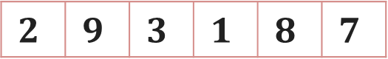
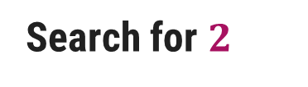

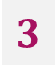
Linear Search - Analysis
The required element in the given array can be found at,
E.g. 2: It is at the first position
Best Case: minimum comparison is required
E.g. 3 or 1: Anywhere after the first position
Average Case: average number of comparison is required
E.g. 7: Last position or element does not found at all
Worst Case: maximum comparison is required
Worst Case
Search for $2$
$$3$$
$$7$$
$$2$$ | $$9$$ | $$3$$ | $$1$$ | $$8$$ | $$7$$
Best Case
Average Case

Slide 13
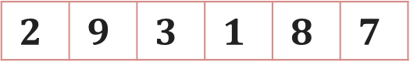


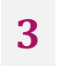
Linear Search - Analysis
The required element in the given array can be found at,
Case 1: element 2 which is at the first position so minimum comparison is required
Case 2: element 3 anywhere after the first position so, an average number of comparison is required
Case 3: element 7 at last position or element does not found at all, maximum comparison is required
Best Case
Average Case
Worst Case
Worst Case
Search for $2$
$$3$$
$$7$$
$$2$$ | $$9$$ | $$3$$ | $$1$$ | $$8$$ | $$7$$
Best Case
Average Case

Slide 14
Analysis of Algorithm
Best Case | Average Case | Worst Case
Resource usage is minimum | Resource usage is average | Resource usage is maximum
Algorithm’s behavior under optimal condition | Algorithm’s behavior under random condition | Algorithm’s behavior under the worst condition
Minimum number of steps or operations | Average number of steps or operations | Maximum number of steps or operations
Lower bound on running time | Average bound on running time | Upper bound on running time
Generally do not occur in real | Average and worst-case performances are the most used in algorithm analysis.

Slide 15
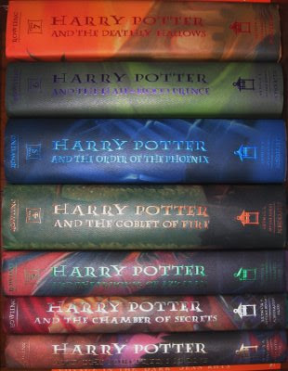
Book Finder Example
Suppose, you are writing a program to find a book from the shelf.
For any required book, it will start checking books one by one from the bottom.
If you wanted Harry Potter 3, it would only take 3 actions (or tries) because it’s the third book in the sequence.
If Harry Potter 7 — it’s the last book so it would have to check all 7 books.
What if there are total 10 books? How about 10,00,000 books? It would take 1 million tries.

Slide 16
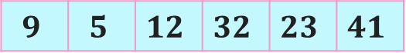
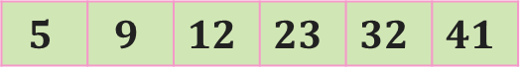
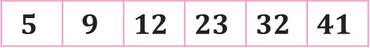
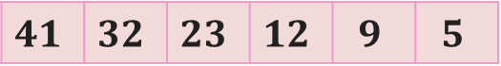
Number Sorting - Example
Suppose you are sorting numbers in Ascending / Increasing order.
The initial arrangement of given numbers can be in any of the following three orders.
Numbers are already in required order, i.e., Ascending order
No change is required – Best Case
Numbers are randomly arranged initially.
Some numbers will change their position – Average Case
Numbers are initially arranged in Descending or Decreasing order.
All numbers will change their position – Worst Case
$$5$$ | $$9$$ | $$12$$ | $$23$$ | $$32$$ | $$41$$
$$9$$ | $$5$$ | $$12$$ | $$32$$ | $$23$$ | $$41$$
$$5$$ | $$9$$ | $$12$$ | $$23$$ | $$32$$ | $$41$$
$$41$$ | $$32$$ | $$23$$ | $$12$$ | $$9$$ | $$5$$

Slide 17
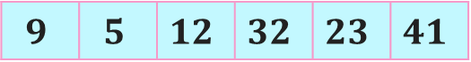
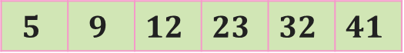
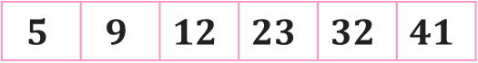
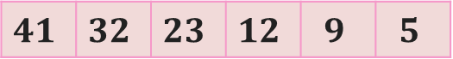
Number Sorting - Example
Suppose you are sorting numbers in Ascending / Increasing order.
The initial arrangement of given numbers can be in any of the following three orders.
Case 1: Numbers are already in required order, i.e., Ascending order
No change is required
Case 2: Numbers are randomly arranged initially. Some numbers will change their position
Case 3: Numbers are initially arranged in Descending order so, all numbers will change their position
Best Case
Average Case
Worst Case
$$5$$ | $$9$$ | $$12$$ | $$23$$ | $$32$$ | $$41$$
$$9$$ | $$5$$ | $$12$$ | $$32$$ | $$23$$ | $$41$$
$$5$$ | $$9$$ | $$12$$ | $$23$$ | $$32$$ | $$41$$
$$41$$ | $$32$$ | $$23$$ | $$12$$ | $$9$$ | $$5$$

Slide 18
Best, Average, & Worst Case
Problem | Best Case | Average Case | Worst Case
Linear Search | Element at the first position | Element in any of the middle positions | Element at last position or not present
Book Finder | The first book | Any book in-between | The last book
Sorting | Already sorted | Randomly arranged | Sorted in reverse order

Slide 19
Asymptotic Notations

Slide 20
Introduction
The theoretical (priori) approach of analyzing an algorithm to measure the efficiency does not depend on the implementation of the algorithm.
In this approach, the running time of an algorithm is describes as Asymptotic Notations.
Computing the running time of algorithm’s operations in mathematical units of computation and defining the mathematical formula of its run-time performance is referred to as Asymptotic Analysis.
An algorithm may not have the same performance for different types of inputs. With the increase in the input size, the performance will change.
Asymptotic analysis accomplishes the study of change in performance of the algorithm with the change in the order of the input size.
Using Asymptotic analysis, we can very well define the best case, average case, and worst case scenario of an algorithm.

Slide 21
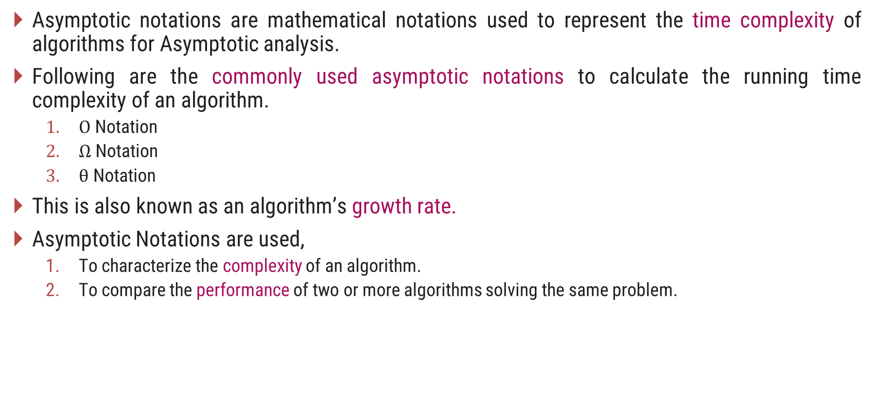
Asymptotic Notations
Asymptotic notations are mathematical notations used to represent the time complexity of algorithms for Asymptotic analysis.
Following are the commonly used asymptotic notations to calculate the running time complexity of an algorithm.
$Ο$ Notation
$Ω$ Notation
$θ$ Notation
This is also known as an algorithm’s growth rate.
Asymptotic Notations are used,
To characterize the complexity of an algorithm.
To compare the performance of two or more algorithms solving the same problem.

Slide 22
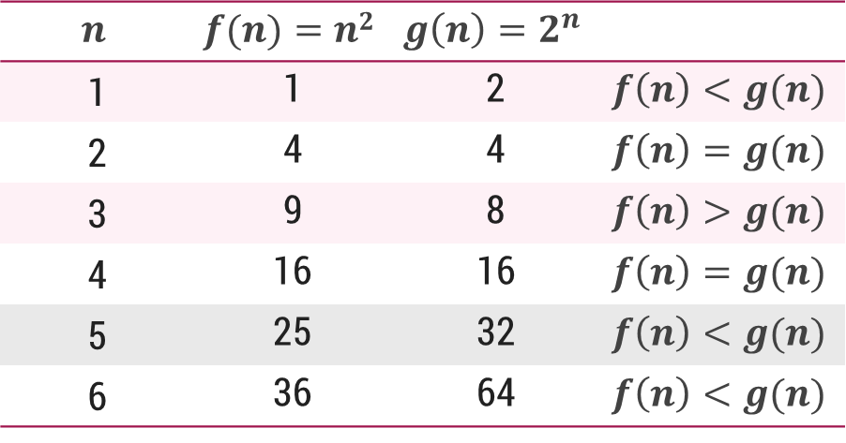



$O$-Notation (Big $O$ notation) (Upper Bound)
The notation $Ο(n)$ is the formal way to express the upper bound of an algorithm's running time.
It measures the worst case time complexity or the longest amount of time an algorithm can possibly take to complete.
For a given function $g(n)$, we denote by $Ο(g(n))$the set of functions,
$Ο(g(n))$= {$f(n)$ : there exist positive constants $c$ and $n0$ such that $0≤f(n)≤cg(n)$for all $n0≤n$}

Slide 23
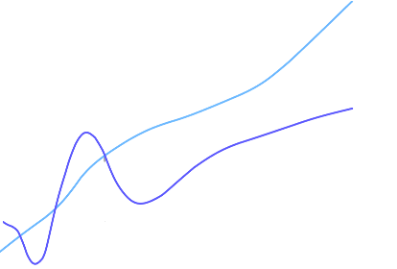
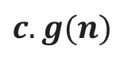
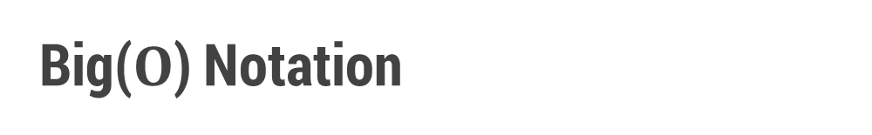
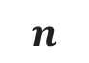
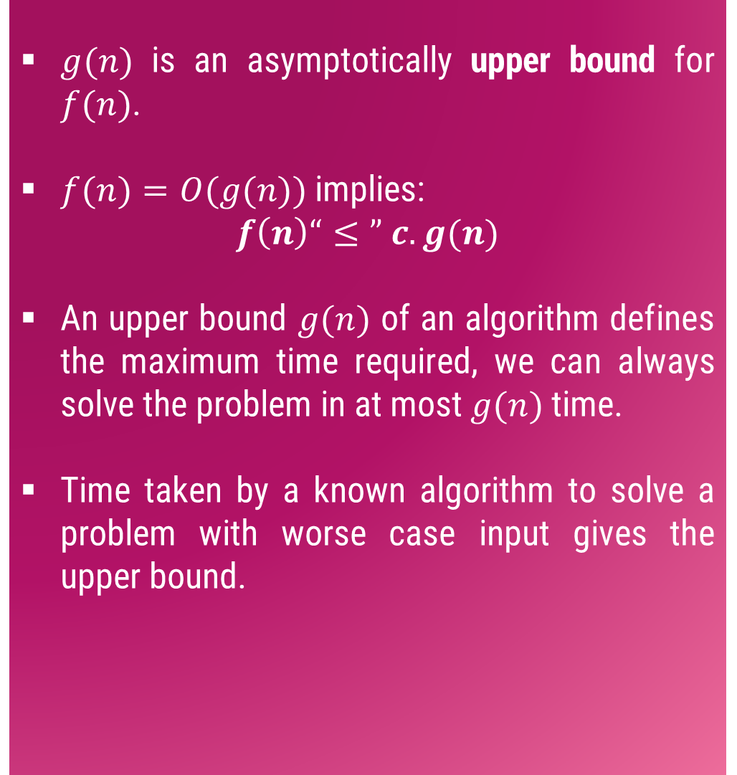
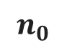
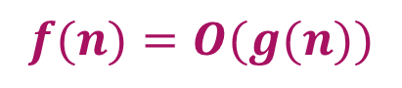
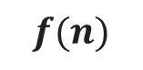
Big($O$) Notation
$g(n)$ is an asymptotically upper bound for $f(n)$.
$f(n)=O(g(n))$implies:
$$f\left(n\right)“≤” c.g(n)$$
An upper bound $g(n)$ of an algorithm defines the maximum time required, we can always solve the problem in at most $g(n)$ time.
Time taken by a known algorithm to solve a problem with worse case input gives the upper bound.
$$c.g(n)$$
$$f(n)$$
$$n$$
$$n_{0}$$
$$f(n)=O(g(n))$$

Slide 24
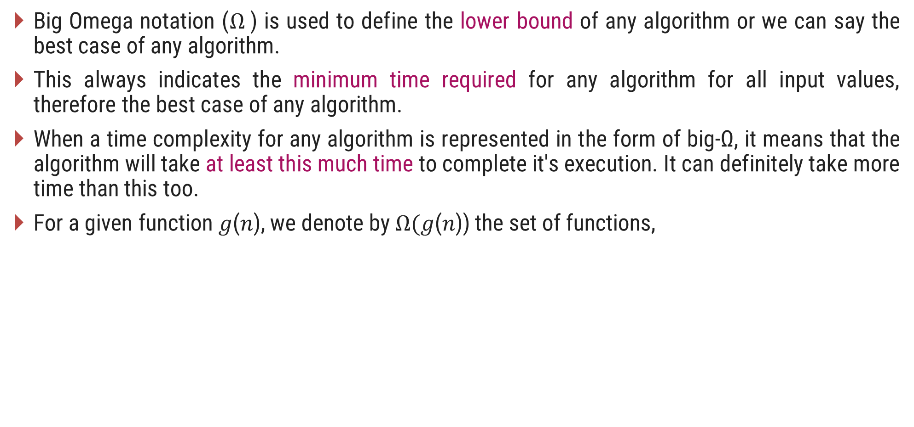


$Ω$-Notation (Omega notation) (Lower Bound)
Big Omega notation ($Ω$) is used to define the lower bound of any algorithm or we can say the best case of any algorithm.
This always indicates the minimum time required for any algorithm for all input values, therefore the best case of any algorithm.
When a time complexity for any algorithm is represented in the form of big-Ω, it means that the algorithm will take at least this much time to complete it's execution. It can definitely take more time than this too.
For a given function 𝑔(𝑛), we denote by $Ω($𝑔(𝑛)) the set of functions,
$Ω(g(n))=\{f(n):$there exist positive constants $c$ and $n_{0}$ such that $0≤cg\left(n\right)≤f\left(n\right)$for all $n_{0}≤n\}$

Slide 25
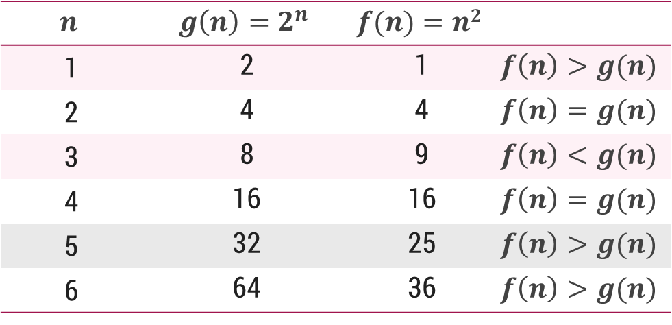


$Ω$-Notation (Omega notation) (Lower Bound)
For a given function 𝑔(𝑛), we denote by $Ω($𝑔(𝑛)) the set of functions,
$Ω(g(n))=\{f(n):$there exist positive constants $c$ and $n_{0}$ such that $0≤cg\left(n\right)≤f\left(n\right)$for all $n_{0}≤n\}$

Slide 26
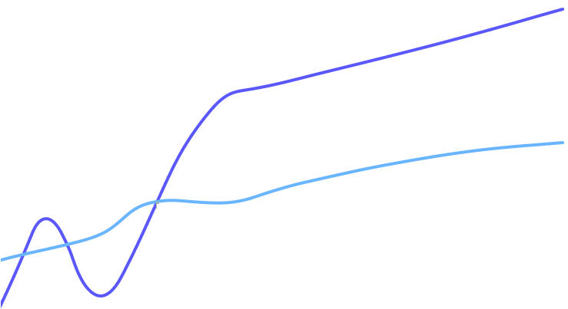
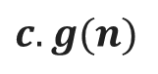
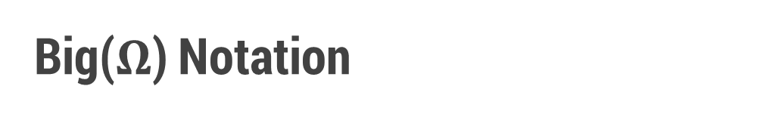
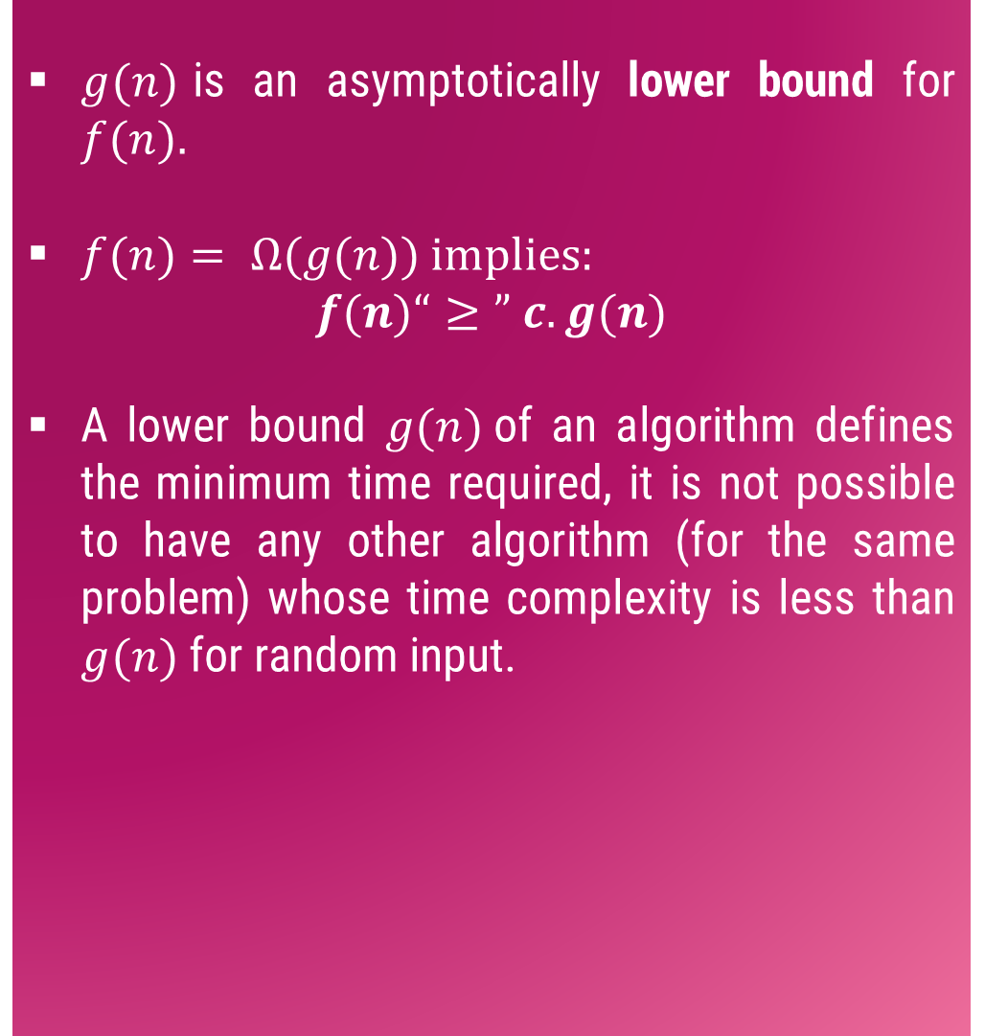
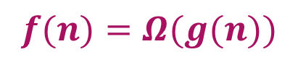
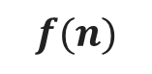
Big($Ω$) Notation
$g(n)$is an asymptotically lower bound for $f(n).$
$f(n)= Ω(g(n))$implies:
$$f(n)“≥” c.g(n)$$
A lower bound $g(n)$of an algorithm defines the minimum time required, it is not possible to have any other algorithm (for the same problem) whose time complexity is less than $g(n)$ for random input.
$$f(n)$$
$$c.g(n)$$
$$n$$
$$n_{0}$$
$$f(n)=Ω(g(n))$$

Slide 27
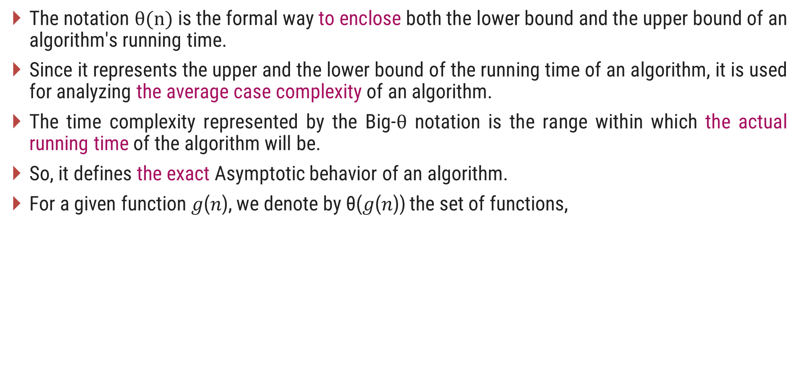


$θ$-Notation (Theta notation) (Same order)
The notation $θ(n)$is the formal way to enclose both the lower bound and the upper bound of an algorithm's running time.
Since it represents the upper and the lower bound of the running time of an algorithm, it is used for analyzing the average case complexity of an algorithm.
The time complexity represented by the Big-$θ$ notation is the range within which the actual running time of the algorithm will be.
So, it defines the exact Asymptotic behavior of an algorithm.
For a given function 𝑔(𝑛), we denote by θ(𝑔(𝑛)) the set of functions,
$θ(g(n))\text{ = \{}f(n)\text{ : }$there exist positive constants $c_{1}\text{, }c_{2} \text{and} n0 \text{such} \text{that} 0≤c_{1}g\left(n\right)≤f\left(n\right)≤c_{2}g\left(n\right) \text{for} \text{all} n0≤n\text{\}}$

Slide 28
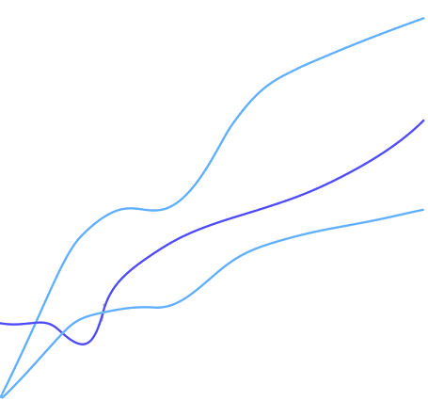
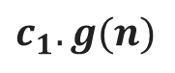
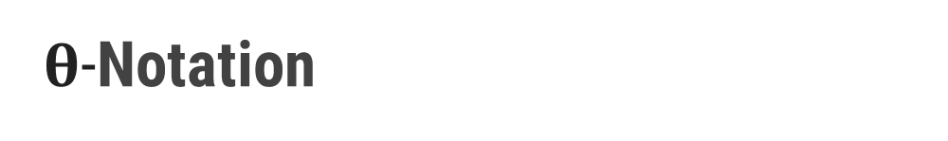
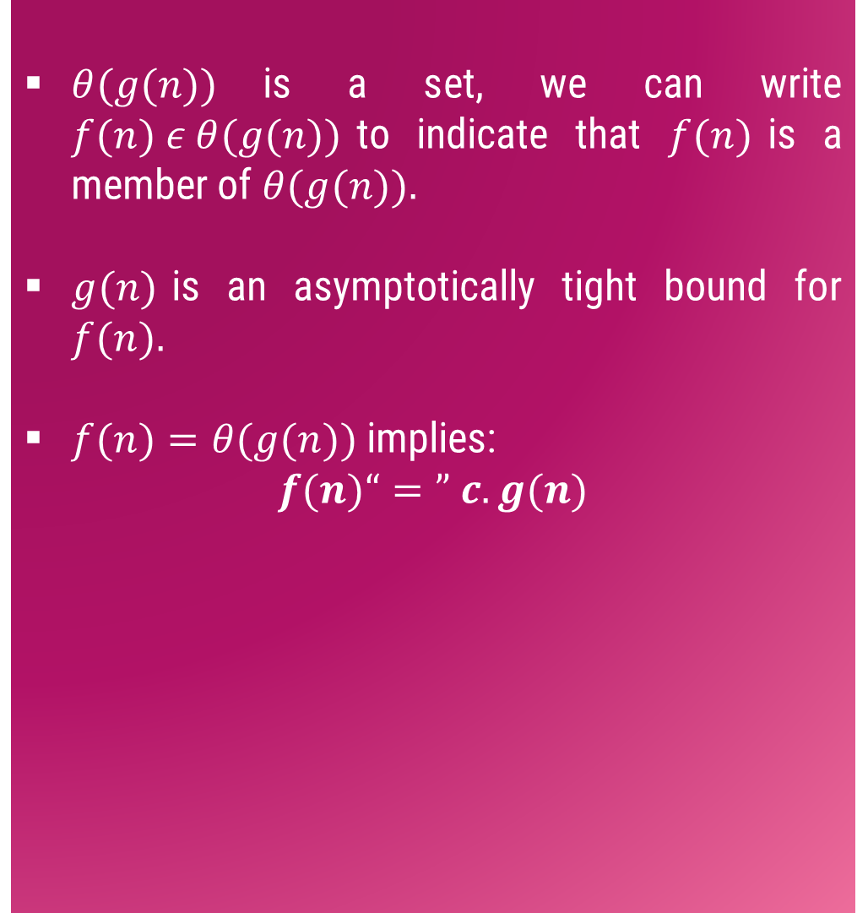





$θ$-Notation
$θ(g(n))$is a set, we can write $f(n) ε θ(g(n))$to indicate that $f(n)$is a member of $θ(g(n)).$
$g(n)$is an asymptotically tight bound for $f(n).$
$f(n)=θ(g(n))$implies:
$$f(n)“=” c.g(n)$$
$$c_{2}.g(n)$$
$$f(n)$$
$$c_{1}.g(n)$$
$$n$$
$$n_{0}$$
$$f(n)=θ(g(n))$$

Slide 29






Asymptotic Notations
O-Notation (Big O notation) (Upper Bound)
Ω-Notation (Omega notation) (Lower Bound)
θ-Notation (Theta notation) (Same order)
$Ο(g(n))$= {$f(n)$ : there exist positive constants $c$ and${ n}_{0}$ such that$0≤f(n)≤g(n)$for all$n0≤n$}
$$f(n)=O(g(n))$$
$\text{Ω}(g(n))$= {$f(n)$ : there exist positive constants $c$ and $n_{0}$ such that $0≤cg\left(n\right)≤f\left(n\right)$ for all $n_{0}≤n$}
$$f\left(n\right)=\text{Ω}(g(n))$$
$θ(g(n))$ = {$f(n)$ : there exist positive constants $c_{1}$, $c_{2}$ and${ n}_{0}$such that $0≤c_{1}g\left(n\right)≤f\left(n\right)≤c_{2}g\left(n\right)$ for all $n_{0}≤n$}
$$f(n)=θ(g(n))$$

Slide 30






Asymptotic Notations – Examples
Example 1:
$f(n)=n^{2}$ and $g\left(n\right)=n$
Example 2:
$f\left(n\right)=n$ and $g\left(n\right)=n^{2}$
Algo. 1 running time
Algo. 2 running time
Algo. 1 running time
Algo. 2 running time
$$f\left(n\right)≥g\left(n\right)⟹f\left(n\right)=\text{Ω}(g(n))$$
$$f\left(n\right)≤g\left(n\right)⟹f\left(n\right)=\text{O}(g(n))$$
$$n$$ | $$f(n)=n2$$ | $$g(n)=n$$
$$n$$ | $$f(n)=n$$ | $$g(n)=n2$$
1
1
1
1
1
1
2
4
2
2
2
4
3
9
3
3
3
9
4
16
4
4
4
16
5
25
5
5
5
25

Slide 31




Asymptotic Notations – Examples
Example 3: $f\left(n\right)=n^{2}$ and $g\left(n\right)= 2^{n}$
$$f\left(n\right)≤g\left(n\right)⟹f\left(n\right)=\text{O}(g(n))$$
$$n$$ | $$f(n)=n2$$ | $$g(n)=2n$$
1 |  |  | $$f(n) < g(n)$$
2 |  |  | $$f(n) = g(n)$$
3 |  |  | $$f(n) > g(n)$$
4 |  |  | $$f(n) = g(n)$$
5 |  |  | $$f(n) < g(n)$$
6 |  |  | $$f(n) < g(n)$$
7 |  |  | $$f(n) < g(n)$$
1
2
4
4
9
8
16
16
Here for $n≥4$, $f\left(n\right)≤g\left(n\right)$
$$so, n0=4$$
25
32
36
64
49
128

Slide 32



Asymptotic Notations – Examples
Example 4:
$f(n)=30n+8$is in the order of $n$, or $O(n)$
$g(n)=n^{2}+1$is order $n^{2}$, or $O(n^{2})$
In general, any $O(n^{2})$ function is faster-growing than any $O(n)$ function.
$$f(n) = O(g(n))$$
g (n)=n²+1
f(n)=30n+8
Value of function →
Base value $n_{0}$
Increasing n →

Slide 33

Common Orders of Magnitude
$$n$$ | $$\log{n}$$ | $$nlog n$$ | $$n2$$ | $$n3$$ | $$2n$$ | $$n!$$
4 | 2 | 8 | 16 | 64 | 16 | 24
16 | 4 | 64 | 256 | 4096 | 65536 | 2.09 x 10¹³
64 | 6 | 384 | 4096 | 262144 | 1.84 × 10¹⁹ | 1.26 x 10²⁹
256 | 8 | 2048 | 65536 | 16777216 | 1.15 × 10⁷⁷ | $$∞$$
1024 | 10 | 10240 | 1048576 | 1.07 × 10⁹ | 1.79 × 10³⁰⁸ | $$∞$$
4096 | 12 | 49152 | 16777216 | 6.87 × 10¹⁰ | 10¹²³³ | $$∞$$

Slide 34





Growth of Function
$$n!$$ | $$en$$ | $$2n$$ | $$n3$$ | $$n2$$ | $$nlogn$$ | $$n$$ | $$\sqrt{n}$$ | $$logn$$ | $$1$$
Arrange the given notations in the increasing order of their values.
For each of the following pairs of functions, either $f(n)$ is $O(g(n))$, $f(n)$ is $Ω(g(n))$, or $f(n) =θ(g(n))$. Determine which relationship is correct.
1. | $$n$$ | $$nlogn$$ | $$2n$$ | $$logn$$ | $$\sqrt{n}$$ | $$en$$ | $$n2+logn$$ | $$n2$$ | $$loglogn$$ | $$n3$$ | $$(logn)2$$ | $$n!$$
2. | $$n8$$ | $$(n^{2}−n+1)4{}^{}$$ | $$nn$$ | $$n^{(1+e)}$$ | $${(1+e) }^{n}$$ | $${n^{2}}/{logn}$$ | $$nlogn$$
$$f(n)=n; g(n)=n^{2}$$ | $$f(n)=10; g(n)=log⁡10$$
$$f(n)=log⁡log⁡n; g(n)=log⁡n$$ | $$f(n)=2^{n}; g(n)=10n^{2}$$
$$f(n)=n; g(n)=\log^{2} n$$ | $$f\left(n\right)=2n; g(n)=3n$$
$$f(n)=n log⁡n + n; g(n)=log⁡n$$ | $$f(n)=n; g(n)=log⁡n^{2}$$

Slide 35

Asymptotic Notations in Equations
Consider an example of buying elephants and goldfish:
Cost = cost_of_elephants + cost_of_goldfish
Cost ≈ cost_of_elephants (approximation)
Maximum Rule: Let, $f, g: N→ R^{+}$ the max rule says that:
$n^{4} + 100n^{2} + 10n + 50 is O(n^{4})$
$10n^{3} + 2n^{2} is O(n^{3})$
$n^{3}$ - $n^{2}$ is $O(n^{3})$
The low order terms in a function are relatively insignificant for large 𝒏
$n^{4} + 100n^{2} + 10n + 50≈ n^{4}$
Negligible
𝑂( 𝑓(𝑛)+𝑔(𝑛))=𝑂(max⁡(𝑓(𝑛),𝑔(𝑛)))

Slide 36
Asymptotic Notations
O-Notation (Big O notation) (Upper Bound)
Ω-Notation (Omega notation) (Lower Bound)
θ-Notation (Theta notation) (Same order)
$Ο(g(n))$= {$f(n)$ : there exist positive constants $c$ and${ n}_{0}$ such that$0≤f(n)≤g(n)$for all$n0≤n$}
$$f(n)=O(g(n))$$
$\text{Ω}(g(n))$= {$f(n)$ : there exist positive constants $c$ and $n_{0}$ such that $0≤cg\left(n\right)≤f\left(n\right)$ for all $n_{0}≤n$}
$$f\left(n\right)=\text{Ω}(g(n))$$
$θ(g(n))$ = {$f(n)$ : there exist positive constants $c_{1}$, $c_{2}$ and${ n}_{0}$such that $0≤c_{1}g\left(n\right)≤f\left(n\right)≤c_{2}g\left(n\right)$ for all $n_{0}≤n$}
$$f(n)=θ(g(n))$$

Slide 37


Expressing Function in terms of 𝑂, $\text{Ω}$, θ notation
Find Big O notation for $f\left(n\right)=2n+6n2+3n$
$$2n+6n2+3n≤2n+6n2+n2$$
$$2n+7n2≤2n+2n$$
$$f\left(n\right)≤4n$$
$$C=2, g\left(n\right)=2n$$
$$f\left(n\right)=O(2n)$$

Slide 38




Expressing Function in terms of 𝑂, $\text{Ω}$, θ notation
Find Big O, Omega $\text{Ω},$Theta θ notation for $f\left(n\right)=2n3+7n2+n+7$
$$2n3+7n2+n+7≤2n3+7n2+n+n$$
$$≤2n3+7n2+2n$$
$$≤2n3+7n2+n2$$
$$≤2n3+8n2$$
$$≤2n3+n3$$
$$≤3n3$$
Thus, $C=3, g\left(n\right)=n3$
Big O Notation:
$$f\left(n\right)≤3g(n3)$$
$$f\left(n\right)=O(n3)$$
Omega $\text{Ω}$ Notation:
$$f\left(n\right)≥2g(n3)$$
$$f\left(n\right)=\text{Ω}(n3)$$
Theta θ Notation:
$2g(n3)$ $≤$ $f\left(n\right)≤3g(n3)$
$$f\left(n\right)=\text{θ}(n3)$$

Slide 39

Exercises
Express the function $n3/1000 − 100n2 − 100n + 3$in terms of θ notation.
Express $20n3 + 10n log⁡n + 5$in terms of O notation.
Express $5n log⁡n + 2n$in terms of O notation.
Prove or disprove (i) Is 2^{n+1} = O(2^{n}) (ii) Is 2^{2n} = O(2^{n})
Check the correctness for the following equality, $5n^{3}+2n=O(n^{3})$
Find θ notation for the following function
$F(n) = 3 ∗ 2n + 4n2 + 5n + 2$
Find O notation for the following function
$F(n) = 2n + 6n2 + 3n$
$F(n) = 4n3 + 2n + 3$
Find Ω notation for the following function
$F(n) = 4∗ 2n + 3n$
$F(n) = 5n3 + n2 + 3n + 2$

Slide 40
Analyzing Control Statements

Slide 41
For Loop
# Input : int A[n], array of n integers
# Output : Sum of all numbers in array A
Algorithm: int Sum(int A[], int n)
{
int s=0;
for (int i=0; i<n; i++)
s = s + A[i];
return s;
}
n+1
1
n
Total time taken = n+1+n+2 = 2n+3
Time Complexity f(n) = 2n+3

Slide 42









Running Time of Algorithm
The time complexity of the algorithm is : $f\left(n\right)= 2 ∙n +3$
Estimated running time for different values of 𝑛 :
As 𝑛 grows, the number of steps grow in linear proportion to 𝑛 for the given algorithm Sum.
The dominating term in the function of time complexity is $n$: As $n$ gets large, the $+3$ becomes insignificant.
The time is linear in proportion to $n$.
$$n=10$$
$23$ steps
$$n=100$$
$203$ steps
$$n=1000$$
$2,003$ steps
$$n=10000$$
$20,003$ steps

Slide 43











Analyzing Control Statements
Example 1:
Example 3:
$$sum=a+b;$$
Statement is executed once only
So, The execution time $T(n)$ is some constant $c≈O(1)$
$$c_{1} \left(n+1\right)$$
$$c$$
$$for i=1 to n do$$
$$for j = 1 to n do$$
$$sum=a+b;$$
Analysis
$$T\left(n\right)=c_{1}\left(n+1\right)+c_{2}n\left(n+1\right)+c_{3}n\left(n\right)$$
$$T(n) =c_{1}n+c_{1}+c_{2}n2+c_{2}n+c_{3}n2$$
$$T(n) = n2(c_{2}+c_{3}) + n(c_{1}+c_{2}) +c_{1}$$
$$T(n) = an2 + bn + c$$
$$T(n)=O\left(n^{2}\right)$$
$$c_{2} n \left(n+1\right)$$
$$c_{3}∗n∗n$$
Example 2:
$$c_{1}$$
$$for i=1 to n do$$
$$sum=a+b;$$
Total time is denoted as,
$$T\left(n\right)=c_{1}n+c_{1}+c_{2}n$$
$$T(n)=n(c_{1}+c_{2})+c_{1}≈O(n)$$
$$∗\left(n+1\right)$$
$$c_{2}$$
$$∗\left(n\right)$$

Slide 44









Analyzing Control Statements
Example 4:
Example 6:
$$l = 0$$
$$for i = 1 to n do$$
$$for j = 1 to i do$$
$$for k = j to n do$$
$$l = l + 1$$
$$for j = 1 to n do$$
$$for k = 1 to j do$$
$$sum = sum + j∗k$$
$$for l =1 to n do$$
$$sum=sum− l + 1$$
printf(“sum is now %d”,$sum$)
$$θ\left(n^{2}\right)$$
$$θ\left(n\right)$$
$$t\left(n\right)=θ\left(n^{3}\right)$$
$$θ\left(1\right)$$
Example 5:
$$l = 0$$
$$for i = 1 to n do$$
$$for j = 1 to n^{2} do$$
$$for k =1 to n^{3} do$$
$$l = l + 1$$
$$t\left(n\right)=θ\left(n^{2}\right)+θ\left(n\right)+θ\left(1\right)$$
$$t\left(n\right)=θ\left(n^{2}\right)$$
$$t\left(n\right)=θ\left(n^{6}\right)$$

Slide 45
Sorting Algorithms
Bubble Sort, Selection Sort, Insertion Sort

Slide 46
Introduction
Sorting is any process of arranging items systematically or arranging items in a sequence ordered by some criterion.
Applications of Sorting
Phone Bill: the calls made are date wise sorted.
Bank statement or Credit card Bill: transactions made are date wise sorted.
Filling forms online: “select country” drop down box will have the name of countries sorted in Alphabetical order.
Online shopping: the items can be sorted price wise, date wise or relevance wise.
Files or folders on your desktop are sorted date wise.

Slide 47

Bubble Sort – Example
Sort the following array in Ascending order
45 | 34 | 56 | 23 | 12
Pass 1 :
45
34
swap
34
34
34
34
45
45
45
45
56
56
56
23
swap
23
23
23
23
56
56
12
swap
12
12
12
12
56
$$if(A[j] > A[j+1])$$
$$swap(A[j],A[j+1])$$

Slide 48
Bubble Sort – Example
Pass 2 :
Pass 3 :
Pass 4 :
34
34
34
34
23
23
23
swap
12
swap
34
45
45
12
23
23
23
34
12
swap
swap
23
12
23
23
34
45
45
12
swap
12
34
12
12
12
45
45
45
45
56
56
56
56
56
56
$$if(A[j] > A[j+1])$$
$$swap(A[j],A[j+1])$$

Slide 49


Bubble Sort - Algorithm
# Input: Array A
# Output: Sorted array A
Algorithm: Bubble_Sort(A)
for i ← 1 to n-1 do
for j ← 1 to n-i do
if A[j] > A[j+1] then
swap(A[j], A[j+1])
$$θ\left(n\right)$$
temp ← A[j]
A[j] ← A[j+1]
A[j+1] ← temp
$$θ\left(n^{2}\right)$$

Slide 50

Bubble Sort
It is a simple sorting algorithm that works by comparing each pair of adjacent items and swapping them if they are in the wrong order.
The pass through the list is repeated until no swaps are needed, which indicates that the list is sorted.
As it only uses comparisons to operate on elements, it is a comparison sort.
Although the algorithm is simple, it is too slow for practical use.
The time complexity of bubble sort is $θ\left(n^{2}\right)$

Slide 51

Bubble Sort Algorithm – Best Case Analysis
# Input: Array A
# Output: Sorted array A
Algorithm: Bubble_Sort(A)
int flag=1;
for i ← 1 to n-1 do
for j ← 1 to n-i do
if A[j] > A[j+1] then
flag = 0;
swap(A[j],A[j+1])
if(flag == 1)
cout<<"already sorted"<<endl
break;
Pass 1 :
i = 1
12
j = 1
23
j = 2
34
j = 3
Condition never becomes true
45
j = 4
59
Best case time complexity = $θ\left(n\right)$

Slide 52

Analysis of Bubble Sort

Slide 53


Analysis of Bubble Sort

Slide 54
Selection Sort – Example 1
Sort the following elements in Ascending order
5 | 1 | 12 | -5 | 16 | 2 | 12 | 14
Step 1 :
Unsorted Array
5 | 1 | 12 | -5 | 16 | 2 | 12 | 14
1 | 2 | 3 | 4 | 5 | 6 | 7 | 8
Step 2 :
Minj denotes the current index and Minx is the value stored at current index.
So, Minj = 1, Minx = 5
Assume that currently Minx is the smallest value.
Now find the smallest value from the remaining entire Unsorted array.
Unsorted Array (elements 2 to 8)
5
-5
1
12
-5
5
16
2
12
14
1
2
3
4
5
6
7
8
Swap
Index = 4, value = -5

Slide 55
Selection Sort – Example 1
Step 3 :
Unsorted Array (elements 3 to 8)
Now Minj = 2, Minx = 1
Find min value from remaining unsorted array
-5
1
1
12
5
16
2
12
14
1
2
3
4
5
6
7
8
Index = 2, value = 1
No Swapping as min value is already at right place
Step 4 :
Unsorted Array
(elements 4 to 8)
Minj = 3, Minx = 12
Find min value from remaining unsorted array
-5
1
12
2
5
16
2
12
12
14
Index = 6, value = 2
1
2
3
4
5
6
7
8
Swap

Slide 56
Selection Sort – Example 1
Step 5 :
Unsorted Array
(elements 5 to 8)
Now Minj = 4, Minx = 5
Find min value from remaining unsorted array
-5
1
2
5
5
16
12
12
14
1
2
3
4
5
6
7
8
Index = 4, value = 5
No Swapping as min value is already at right place
Step 6 :
Minj = 5, Minx = 16
Find min value from remaining unsorted array
Unsorted Array
(elements 6 to 8)
Index = 6, value = 12
-5
1
2
5
16
12
12
16
12
14
1
2
3
4
5
6
7
8
Swap

Slide 57
Selection Sort – Example 1
Step 7 :
Unsorted Array
(elements 7 to 8)
Now Minj = 6, Minx = 16
Find min value from remaining unsorted array
-5
1
2
5
12
16
12
12
16
14
1
2
3
4
5
6
7
8
Index = 7, value = 12
Swap
Step 8 :
Unsorted Array
(element 8)
Minj = 7, Minx = 16
Find min value from remaining unsorted array
-5
1
2
5
12
12
16
14
14
16
Index = 8, value = 14
1
2
3
4
5
6
7
8
Swap
The entire array is sorted now.

Slide 58

Selection Sort
Selection sort divides the array or list into two parts,
The sorted part at the left end
and the unsorted part at the right end.
Initially, the sorted part is empty and the unsorted part is the entire list.
The smallest element is selected from the unsorted array and swapped with the leftmost element, and that element becomes a part of the sorted array.
Then it finds the second smallest element and exchanges it with the element in the second leftmost position.
This process continues until the entire array is sorted.
The time complexity of selection sort is $θ\left(n^{2}\right)$

Slide 59


Selection Sort - Algorithm
# Input: Array A
# Output: Sorted array A
Algorithm: Selection_Sort(A)
for i ← 1 to n-1 do
minj ← i;
minx ← A[i];
for j ← i + 1 to n do
if A[j] < minx then
minj ← j;
minx ← A[j];
A[minj] ← A[i];
A[i] ← minx;
$$θ\left(n\right)$$
$$θ\left(n^{2}\right)$$

Slide 60
Selection Sort – Example 2
Algorithm: Selection_Sort(A)
for i ← 1 to n-1 do
minj ← i; minx ← A[i];
for j ← i + 1 to n do
if A[j] < minx then
minj ← j ; minx ← A[j];
A[minj] ← A[i];
A[i] ← minx;
Pass 1 :
i = 1
2
minj ← 1
34
34
No Change
minx ← 45
j = 2
3
A[j] = 34
56
Sort in Ascending order
45 | 34 | 56 | 23 | 12
45
1 | 2 | 3 | 4 | 5

Slide 61
Selection Sort – Example 2
Algorithm: Selection_Sort(A)
for i ← 1 to n-1 do
minj ← i; minx ← A[i];
for j ← i + 1 to n do
if A[j] < minx then
minj ← j ; minx ← A[j];
A[minj] ← A[i];
A[i] ← minx;
Pass 1 :
i = 1
4
minj ← 2
5
minx ← 34
12
23
j = 2
3
4
5
A[j] = 23
12
Sort in Ascending order
Unsorted Array
45 | 34 | 56 | 23 | 12
45
45 | 34 | 56 | 23 | 12
12
45
1 | 2 | 3 | 4 | 5
1 | 2 | 3 | 4 | 5
Swap
34
56
34
45
45 | 34 | 56 | 23 | 45
12
23
56

Slide 62

Selection Sort Analysis

Slide 63




Insertion Sort – Example
Sort the following elements in Ascending order
5 | 1 | 12 | -5 | 16 | 2 | 12 | 14
Step 1 :
Unsorted Array
5 | 1 | 12 | -5 | 16 | 2 | 12 | 14
1 | 2 | 3 | 4 | 5 | 6 | 7 | 8
Step 2 :
$$j$$
$$i=2, x=1$$
$$j=i –1 and j>0$$
1
5
1
12
-5
16
2
12
14
while $x<T\left[j\right]$ do
$$T\left[j+1\right]←T\left[j\right]$$
$$j−−$$
1
2
3
4
5
6
7
8
Shift down

Slide 64









Insertion Sort – Example
Step 3 :
$$j$$
$$i=3, x=12$$
$$j=i –1 and j>0$$
1
5
12
-5
16
2
12
14
while $x<T\left[j\right]$ do
$$T\left[j+1\right]←T\left[j\right]$$
$$j−−$$
1
2
3
4
5
6
7
8
No Shift will take place
Step 4 :
$$i=4, x=−5$$
$$j=i –1 and j>0$$
$$j$$
while $x<T\left[j\right]$ do
$$T\left[j+1\right]←T\left[j\right]$$
$$j−−$$
$$j$$
-5
1
5
12
-5
16
2
12
14
1
2
3
4
5
6
7
8
Shift down
Shift down
Shift down

Slide 65







Insertion Sort – Example
Step 5 :
$$j$$
$$i=5, x=16$$
$$j=i –1 and j>0$$
-5
1
5
12
16
2
12
14
while $x<T\left[j\right]$ do
$$T\left[j+1\right]←T\left[j\right]$$
$$j−−$$
1
2
3
4
5
6
7
8
No Shift will take place
Step 6 :
$$i=6, x=2$$
$$j=i –1 and j>0$$
$$j$$
$$j$$
while $x<T\left[j\right]$ do
$$T\left[j+1\right]←T\left[j\right]$$
$$j−−$$
-5
1
2
5
12
16
2
12
14
1
2
3
4
5
6
7
8
Shift down
Shift down
Shift down

Slide 66







Insertion Sort – Example
Step 7 :
$$j$$
$$i=7, x=12$$
$$j=i –1 and j>0$$
-5
1
2
5
12
12
16
12
14
while $x<T\left[j\right]$ do
$$T\left[j+1\right]←T\left[j\right]$$
$$j−−$$
1
2
3
4
5
6
7
8
Shift down
Step 8 :
$$i=8, x=14$$
$$j=i –1 and j>0$$
$$j$$
while $x<T\left[j\right]$ do
$$T\left[j+1\right]←T\left[j\right]$$
$$j−−$$
-5
1
2
5
12
12
14
16
14
1
2
3
4
5
6
7
8
Shift down
The entire array is sorted now.

Slide 67


Insertion Sort - Algorithm
# Input: Array T
# Output: Sorted array T
Algorithm: Insertion_Sort(T[1,…,n])
for i ← 2 to n do
x ← T[i];
j ← i – 1;
while x < T[j] and j > 0 do
T[j+1] ← T[j];
j ← j – 1;
T[j+1] ← x;
$$θ\left(n\right)$$
$$θ\left(n^{2}\right)$$

Slide 68

Insertion Sort Algorithm – Best Case Analysis
# Input: Array T
# Output: Sorted array T
Algorithm: Insertion_Sort(T[1,…,n])
for i ← 2 to n do
x ← T[i];
j ← i – 1;
while x < T[j] and j > 0 do
T[j+1] ← T[j];
j ← j – 1;
T[j+1] ← x;
Pass 1 :
12
23
i=2
x=23
T[j]=12
34
i=3
x=34
T[j]=23
$$θ\left(n\right)$$
45
i=4
x=45
T[j]=34
59
i=5
x=59
T[j]=45
The best case time complexity of Insertion sort is $θ\left(n\right)$
The average and worst case time complexity of Insertion sort is $θ\left(n^{2}\right)$

Slide 69
Heap & Heap Sort Algorithm

Slide 70
Introduction
A heap data structure is a binary tree with the following two properties.
It is a complete binary tree: Each level of the tree is completely filled, except possibly the bottom level. At this level it is filled from left to right.
It satisfies the heap order property: the data item stored in each node is greater than or equal to the data item stored in its children node.
a
a
9
9
b
c
b
c
6
7
6
7
d
e
f
d
e
f
2
4
8
2
4
1
Binary Tree but not a Heap
Complete Binary Tree - Heap
Not a Heap
Heap

Slide 71
Array Representation of Heap
Heap can be implemented using an Array.
An array 𝐴 that represents a heap is an object with two attributes:
𝑙𝑒𝑛𝑔𝑡ℎ[𝐴], which is the number of elements in the array, and
ℎ𝑒𝑎𝑝−𝑠𝑖𝑧𝑒[𝐴], the number of elements in the heap stored within array 𝐴
16
14
10
8
7
9
3
Array representation of heap
2
4
1
16
14
10
8
7
9
3
2
4
1
Heap

Slide 72













Array Representation of Heap
In the array 𝐴, that represents a heap
length[𝐴] = heap-size[𝐴]
For any node 𝒊 the parent node is 𝒊/𝟐
For any node 𝒋, its left child is 𝟐𝒋 and right child is 𝟐𝒋+𝟏
For node $i=4$, parent node is $4/2=2$
$$1$$
16
For node $i=4$,
Left child node is $2∗4=$node $8$
Right child is $2∗4+1=$node $9$
$$2$$
$$3$$
14
10
$$4$$
$$5$$
$$6$$
$$7$$
8
7
9
3
$$1$$ | $$2$$ | $$3$$ | $$4$$ | $$5$$ | $$6$$ | $$7$$ | $$8$$ | $$9$$ | $$10$$
$$8$$
$$9$$
$$10$$
14
8
2
4
2
4
1
16
14
10
8
7
9
3
2
4
1
Heap

Slide 73
Types of Heap
Max-Heap − Where the value of the root node is greater than or equal to either of its children.
9
6
7
2
4
1
1
Min-Heap − Where the value of the root node is less than or equal to either of its children.
2
4
6
7
9

Slide 74
Introduction to Heap Sort
Build the complete binary tree using given elements.
Create Max-heap to sort in ascending order.
Once the heap is created, swap the last node with the root node and delete the last node from the heap.
Repeat step 2 and 3 until the heap is empty.

Slide 75

Heap Sort – Example 1
Sort the following elements in Ascending order
4 | 10 | 3 | 5 | 1
Step 1 : Create Complete Binary Tree
4
$$1$$ | $$2$$ | $$3$$ | $$4$$ | $$5$$
4 | 10 | 3 | 5 | 1
10
3
Now, a binary tree is created and we have to convert it into a Heap.
5
1

Slide 76
Heap Sort – Example 1
Sort the following elements in Ascending order
4 | 10 | 3 | 5 | 1
Step 2 : Create Max Heap
4
10
10 is greater than 4
So, swap 10 & 4
$$1$$ | $$2$$ | $$3$$ | $$4$$ | $$5$$
4 | 10 | 3 | 5 | 1
10
4
10
3
4
Swap
In a Max Heap, parent node is always greater than or equal to the child nodes.
5
1

Slide 77
Heap Sort – Example 1
Sort the following elements in Ascending order
4 | 10 | 3 | 5 | 1
Step 2 : Create Max Heap
10
5 is greater than 4
So, swap 5 & 4
$$1$$ | $$2$$ | $$3$$ | $$4$$ | $$5$$
10 | 4 | 3 | 5 | 1
5
4
4
3
5
Swap
In a Max Heap, parent node is always greater than or equal to the child nodes.
5
1
4
Max Heap is created

Slide 78
Heap Sort – Example 1
Sort the following elements in Ascending order
4 | 10 | 3 | 5 | 1
Step 3 : Apply Heap Sort
10
1
$$1$$ | $$2$$ | $$3$$ | $$4$$ | $$5$$
10 | 5 | 3 | 4 | 1
1
10
5
3
Swap
Swap the first and the last nodes and
Delete the last node.
4
1
10

Slide 79
Heap Sort – Example 1
Sort the following elements in Ascending order
4 | 10 | 3 | 5 | 1
Step 3 : Apply Heap Sort
1
5
Max Heap Property is violated so, create a Max Heap again.
$$1$$ | $$2$$ | $$3$$ | $$4$$ | $$5$$
1 | 5 | 3 | 4 | 10
5
1
1
4
5
3
1
4
Swap
4
1

Slide 80
Heap Sort – Example 1
Sort the following elements in Ascending order
4 | 10 | 3 | 5 | 1
Step 3 : Apply Heap Sort
5
1
Max Heap is created
$$1$$ | $$2$$ | $$3$$ | $$4$$ | $$5$$
5 | 4 | 3 | 1 | 10
1
5
4
3
Swap
Swap the first and the last nodes and
Delete the last node.
1
5

Slide 81
Heap Sort – Example 1
Sort the following elements in Ascending order
4 | 10 | 3 | 5 | 1
Step 3 : Apply Heap Sort
1
Create Max Heap again
3
4
$$1$$ | $$2$$ | $$3$$ | $$4$$ | $$5$$
1 | 4 | 3 | 5 | 10
4
1
4
3
Max Heap is created
4
3
1
4
Swap
Swap the first and the last nodes and
Delete the last node.

Slide 82
Heap Sort – Example 1
Sort the following elements in Ascending order
4 | 10 | 3 | 5 | 1
Step 3 : Apply Heap Sort
3
Already a Max Heap
1
$$1$$ | $$2$$ | $$3$$ | $$4$$ | $$5$$
3 | 1 | 4 | 5 | 10
1
3
1
3
Swap
Swap the first and the last nodes and
Delete the last node.

Slide 83
Heap Sort – Example 1
Sort the following elements in Ascending order
4 | 10 | 3 | 5 | 1
Step 3 : Apply Heap Sort
1
Already a Max Heap
$$1$$ | $$2$$ | $$3$$ | $$4$$ | $$5$$
1 | 3 | 4 | 5 | 10
1
Remove the last element from heap and the sorting is over.

Slide 84
Heap Sort – Example 2
Sort given element in ascending order using heap sort. 19, 7, 16, 1, 14, 17
19 | 7 | 16 | 1 | 14 | 17
14
17
7
16
Step 1: Create binary tree
Step 2: Create Max-heap
19
19
7
16
7
16
14
17
1
14
17
1
14
17
7
16

Slide 85
Heap Sort – Example 2
Step 3
Step 4
19 | 14 | 17 | 1 | 7 | 16
16 | 14 | 17 | 1 | 7 | 19
16
19
17
16
19
16
Create Max-heap
16
17
Swap & remove the last element
14
17
14
17
16
1
7
16
1
7
19

Slide 86
Heap Sort – Example 2
Step 5
Step 6
17 | 14 | 16 | 1 | 7 | 19
7 | 14 | 16 | 1 | 17 | 19
7
17
16
7
17
7
Create Max-heap
7
16
Swap & remove the last element
14
16
14
16
7
1
7
1
17

Slide 87
Heap Sort – Example 2
Step 7
Step 8
16 | 14 | 7 | 1 | 17 | 19
1 | 14 | 7 | 16 | 17 | 19
1
16
14
1
16
1
Create Max-heap
1
14
Swap & remove the last element
14
7
14
7
1
1
16

Slide 88
Heap Sort – Example 2
Step 9
Step 10
14 | 1 | 7 | 16 | 17 | 19
7 | 1 | 14 | 16 | 17 | 19
7
14
1
7
14
7
Already a Max-heap
7
Swap & remove the last element
1
Swap & remove the last element
1
7
1
14
7
Step 11
1 | 7 | 14 | 16 | 17 | 19
1 | 7 | 14 | 16 | 17 | 19
1
Remove the last element
The entire array is sorted now.

Slide 89
Exercises
Sort the following elements using Heap Sort Method.
34, 18, 65, 32, 51, 21
20, 50, 30, 75, 90, 65, 25, 10, 40
Sort the following elements in Descending order using Hear Sort Algorithm.
65, 77, 5, 23, 32, 45, 99, 83, 69, 81

Slide 90

Binary Tree Analysis

Slide 91

Heap Sort – Algorithm
# Input: Array A
# Output: Sorted array A
Algorithm: Heap_Sort(A[1,…,n])
BUILD-MAX-HEAP(A)
for i $←$ length[A] downto 2
do exchange A[1] $↔$ A[i]
heap-size[A] $←$ heap-size[A] – 1
MAX-HEAPIFY(A, 1, n)

Slide 92
Heap Sort – Algorithm
Algorithm: BUILD-MAX-HEAP(A)
heap-size[A] ← length[A]
for i ← ⌊length[A]/2⌋ downto 1
do MAX-HEAPIFY(A, i)
4 | 1 | 3 | 2 | 9 | 7
1
4
2
3
1
3
4
5
6
heap-size[A] = 6
2
9
7
4 | 1 | 7 | 2 | 9 | 3
4 | 9 | 7 | 2 | 1 | 3
9 | 4 | 7 | 2 | 1 | 3
i = 3
1
4
i = 2
1
i = 1
1
4
4
9
2
3
2
3
2
3
1
3
7
9
7
7
1
9
4
4
5
6
4
5
6
4
5
6
2
9
7
2
9
3
2
1
3
3
1

Slide 93

Heap Sort – Algorithm
# Input: Array A
# Output: Sorted array A
Algorithm: Heap_Sort(A[1,…,n])
BUILD-MAX-HEAP(A)
for i $←$ length[A] downto 2
do exchange A[1] $↔$ A[i]
heap-size[A] $←$ heap-size[A] – 1
MAX-HEAPIFY(A, 1, n)
3 | 4 | 7 | 2 | 1 | 9
9 | 4 | 7 | 2 | 1 | 3
1
9
2
3
4
7
4
5
6
2
1
3

Slide 94





Heap Sort – Algorithm
Algorithm: Max-heapify(A, i, n)
l $←$ LEFT(i)
r $←$ RIGHT(i)
if l ≤ n and A[l] > A[i]
then largest $←$l
else largest $←$i
if r ≤ n and A[r] > A[largest]
then largest $←$r
if largest $≠$ i
then exchange A[i] $↔$ A[largest]
MAX-HEAPIFY(A, largest, n)
3 | 4 | 7 | 2 | 1 | 9
l $←$ 2
1
r $←$ 3
1
3
Yes
2
3
largest $←$ 2
4
7
4
5
Yes
2
1
largest $←$ 3
Yes

Slide 95
Heap Sort – Algorithm
# Input: Array A
# Output: Sorted array A
Algorithm: Heap_Sort(A[1,…,n])
BUILD-MAX-HEAP(A)
for i $←$ length[A] downto 2
do exchange A[1] $↔$ A[i]
heap-size[A] $←$ heap-size[A] – 1
MAX-HEAPIFY(A, 1, n)
3 | 4 | 7 | 2 | 1 | 9
1
7
2
3
4
3
4
5
2
1

Slide 96






Heap Sort Algorithm – Analysis
# Input: Array A
# Output: Sorted array A
Algorithm: Heap_Sort(A[1,…,n])
BUILD-MAX-HEAP(A)
for i $←$ length[A] downto 2
do exchange A[1] $↔$ A[i]
heap-size[A] $←$ heap-size[A] – 1
MAX-HEAPIFY(A, 1, n)
heap-size[A] ← length[A]
for i ← ⌊length[A]/2⌋ downto 1
do MAX-HEAPIFY(A, i)
$$n/2$$
$$O(n log⁡n)$$
$$O( log⁡n)$$
$$n−1$$
$$O(n−1) (logn)$$
Running time of heap sort algorithm is:
$$O\left(n log n\right)+O(\log{n)\left(n−1\right)+O(n−1)=O(n\log{n)}}$$

Slide 97
Sorting Algorithms
Shell Sort, Radix Sort, Bucket Sort, Counting Sort

Slide 98


Shell Sort - Example
Sort the following elements in ascending order using shell sort.
This algorithm avoids large shifts as in case of insertion sort, if the smaller value is to the far right and has to be moved to the far left.
80
93
60
12
42
30
68
85
10
Step 1: Divide input array into segments, where Initial Segmenting Gap = 4 (n/2)
$$1$$ | $$2$$ | $$3$$ | $$4$$ | $$5$$ | $$6$$ | $$7$$ | $$8$$ | $$9$$
80
93
60
12
42
30
68
85
10
Each segment is sorted within itself using insertion sort
$$1$$ | $$2$$ | $$3$$ | $$4$$ | $$5$$ | $$6$$ | $$7$$ | $$8$$ | $$9$$
10
93
60
12
42
30
68
85
80

Slide 99



Shell Sort - Example
Sort the following elements in ascending order using shell sort.
80
93
60
12
42
30
68
85
10
Step 1: Divide input array into segments, where Initial Segmenting Gap = 4 (n/2)
$$1$$ | $$2$$ | $$3$$ | $$4$$ | $$5$$ | $$6$$ | $$7$$ | $$8$$ | $$9$$
10
30
60
12
42
93
68
85
80
$$1$$ | $$2$$ | $$3$$ | $$4$$ | $$5$$ | $$6$$ | $$7$$ | $$8$$ | $$9$$
Each segment is sorted within itself using insertion sort
10
30
60
12
42
93
68
85
80
$$1$$ | $$2$$ | $$3$$ | $$4$$ | $$5$$ | $$6$$ | $$7$$ | $$8$$ | $$9$$
10
30
60
12
42
93
68
85
80

Slide 100



Shell Sort - Example
Sort the following elements in ascending order using shell sort.
80
93
60
12
42
30
68
85
10
Step 2: Now, the Segmenting Gap = 2 (4/2)
$$1$$ | $$2$$ | $$3$$ | $$4$$ | $$5$$ | $$6$$ | $$7$$ | $$8$$ | $$9$$
10
30
60
12
42
93
68
85
80
$$1$$ | $$2$$ | $$3$$ | $$4$$ | $$5$$ | $$6$$ | $$7$$ | $$8$$ | $$9$$
Each segment is sorted within itself using insertion sort
10
30
42
12
60
93
68
85
80
$$1$$ | $$2$$ | $$3$$ | $$4$$ | $$5$$ | $$6$$ | $$7$$ | $$8$$ | $$9$$
10
12
42
30
60
85
68
93
80

Slide 101

Shell Sort - Example
Sort the following elements in ascending order using shell sort.
80
93
60
12
42
30
68
85
10
Step 3: Now, the Segmenting Gap = 1 (2/2)
$$1$$ | $$2$$ | $$3$$ | $$4$$ | $$5$$ | $$6$$ | $$7$$ | $$8$$ | $$9$$
10
12
42
30
60
85
68
93
80
Each segment is sorted within itself using insertion sort
$$1$$ | $$2$$ | $$3$$ | $$4$$ | $$5$$ | $$6$$ | $$7$$ | $$8$$ | $$9$$
10
12
30
42
60
68
80
85
93
The entire array is sorted now.

Slide 102

Shell Sort - Procedure
Divide the array into several smaller non contiguous segments.
The distance between successive elements in one segment is called a gap.
Each segment is sorted within itself using insertion sort.
Then re-segment into larger segments (smaller gap) and repeat sorting process.
Continue until only one segment is left, i.e., gap = 1.
Final sorting finishes the entire array sorting.
Time complexity of shell sort is $O(n2)$

Slide 103
Radix Sort
Radix Sort puts the elements in order by comparing the digits of the numbers.
Each element in the 𝒏-element array 𝑨 has 𝒅 digits, where digit 1 is the lowest-order digit and digit 𝑑 is the highest order digit.
Sort following elements in Ascending order using radix sort.
363, 729, 329, 873, 691, 521, 435, 297
Algorithm: RADIX-SORT(A, d)
for i ← 1 to d
do use a stable sort to sort array A on digit i

Slide 104
Radix Sort - Example
3 6 3
6 9 1
5 2 1
7 2 9
5 2 1
7 2 9
3 2 9
3 6 3
3 2 9
8 7 3
8 7 3
4 3 5
6 9 1
4 3 5
3 6 3
5 2 1
2 9 7
8 7 3
4 3 5
7 2 9
6 9 1
2 9 7
3 2 9
2 9 7
Sort on column 1
Sort on column 2
The entire array is sorted now.
Sort on column 3

Slide 105

Bucket Sort – Introduction
Sort the following elements in Ascending order using bucket sort.
Create $n$ empty buckets.
Add each input element to appropriate bucket as,
Bucket $i$holds values in the half-open interval,
$$i∗10 ≤ A[i] < (i+1)∗10$$
Sort each bucket queue with insertion sort.
Merge all bucket queues together in order.
Expected running time is $O(n + N),$with $n$ = size of original sequence. If $N$ is $O(n)$ then sorting algorithm in $O(n).$
45 | 96 | 29 | 30 | 27 | 12 | 39 | 61 | 91

Slide 106
Bucket Sort – Example
45 | 96 | 29 | 30 | 27 | 12 | 39 | 61 | 91
45
96
29
30
27
12
39
61
91
29
96
27
39
91
12
27
30
29
45
61
91
96
0
1
2
3
4
5
6
7
8
9
Sort each bucket queue with insertion sort
Merge all bucket queues together in order
12 | 27 | 29 | 30 | 39 | 45 | 61 | 91 | 96

Slide 107
Bucket Sort - Algorithm
# Input: Array A
# Output: Sorted array A
Algorithm: Bucket-Sort(A[1,…,n])
n ← length[A]
for i ← 1 to n do
insert A[i] into bucket B[⌊A[i] ÷ n ⌋]
for i ← 0 to n – 1 do
sort bucket B[i] with insertion sort
concatenate the buckets B[0], B[1], . . ., B[n - 1] together in order.

Slide 108




Counting Sort – Example
Sort the following elements in Ascending order using counting sort.
3 | 6 | 4 | 1 | 3 | 4 | 1 | 4 | 2
Step 1
Given elements are stored in an input array $A[1,…,9]$
Index
$$1$$ | $$2$$ | $$3$$ | $$4$$ | $$5$$ | $$6$$ | $$7$$ | $$8$$ | $$9$$
Elements
3 | 6 | 4 | 1 | 3 | 4 | 1 | 4 | 2
Step 2
Define a temporary array $C$. The size of an array$C$is equal to the maximum element in array $A$. Initialize $C[1,…,6] \text{to} 0$.
Index
$$1$$ | $$2$$ | $$3$$ | $$4$$ | $$5$$ | $$6$$
0 | 0 | 0 | 0 | 0 | 0
Elements

Slide 109



Counting Sort – Example
Sort the following elements in Ascending order using counting sort.
Input array$A$
3 | 6 | 4 | 1 | 3 | 4 | 1 | 4 | 2
Step 3
Update an array C with the occurrences of each value of array 𝐴
Index
$$1$$ | $$2$$ | $$3$$ | $$4$$ | $$5$$ | $$6$$
0 | 0 | 0 | 0 | 0 | 0
Elements
2
1
2
3
0
1
+
+
Step 4
In array 𝐶, from index 2 to 𝑛 add the value with previous element
Index
$$1$$ | $$2$$ | $$3$$ | $$4$$ | $$5$$ | $$6$$
2 | 3 | 5 | 8 | 8 | 9
Elements

Slide 110




Counting Sort – Example
Create an output array 𝐵[1…9]. Start positioning elements of Array 𝐴 𝑡𝑜 𝐵 as shown below.
$$1$$ | $$2$$ | $$3$$ | $$4$$ | $$5$$ | $$6$$ | $$7$$ | $$8$$ | $$9$$
3 | 6 | 4 | 1 | 3 | 4 | 1 | 4 | 2
Input array$A$
$$1$$ | $$2$$ | $$3$$ | $$4$$ | $$5$$ | $$6$$
2 | 3 | 5 | 8 | 8 | 9
Temporary Array C
1
2
4
6
7
0
3
5
8
$$1$$ | $$2$$ | $$3$$ | $$4$$ | $$5$$ | $$6$$ | $$7$$ | $$8$$ | $$9$$
1 | 1 | 2 | 3 | 3 | 4 | 4 | 4 | 6
Output Array B

Slide 111
Counting Sort - Procedure
Counting sort assumes that each of the 𝑛 input elements is an integer in the range 0 to 𝑘, for some integer 𝑘.
When 𝒌=𝑶(𝒏), the counting sort runs in 𝜽(𝒏) time.
The basic idea of counting sort is to determine, for each input element 𝑥, the number of elements less than 𝑥.
This information can be used to place element 𝑥 directly into its position in the output array.

Slide 112

Counting Sort - Algorithm
# Input: Array A
# Output: Sorted array A
Algorithm: Counting-Sort(A[1,…,n], B[1,…,n], k)
for i ← 1 to k do
c[i] ← 0
for j ← 1 to n do
c[A[j]] ← c[A[j]] + 1
for i ← 2 to k do
c[i] ← c[i] + c[i-1]
for j ← n downto 1 do
B[c[A[j]]] ← A[j]
c[A[j]] ← c[A[j]] - 1

Slide 113
Amortized Analysis

Slide 114
Introduction
Amortized analysis considers not just one operation, but a sequence of operations on a given data structure or a database.
Amortized Analysis is used for algorithms where an occasional operation is very slow, but most of the other operations are faster.
The time required to perform a sequence of data structure operations is averaged over all operations performed.
In Amortized Analysis, we analyze a sequence of operations and guarantee a worst case average time which is lower than the worst case time of a particular expensive operation.
So, Amortized analysis can be used to show that the average cost of an operation is small even though a single operation might be expensive.

Slide 115
Amortized Analysis Techniques
There are three most common techniques of amortized analysis,
The aggregate method
A sequence of 𝑛 operation takes worst case time 𝑇(𝑛)
Amortized cost per operation is 𝑇(𝑛)/𝑛
The accounting method
Assign each type of operation an (different) amortized cost
Overcharge some operations
Store the overcharge as credit on specific objects
Then use the credit for compensation for some later operations
The potential method
Same as accounting method
But store the credit as “potential energy” and as a whole.

Slide 116

Amortized Analysis - Example
Incrementing a Binary Counter
Implementing a $k$-bit binary counter that counts upward from $0 to n$.
Use array $A[0…k−1]$ of bits as the counter where,
$length[A]=k$
$A[0]$ is the least significant bit.
$A[k−1]$is the most significant bit.
Counter value
Increment cost
Total cost
[7]
[6]
[5]
[4]
[3]
[2]
[1]
[0]
0
0
0
0
0
0
0
0
0
0
1
0
0
0
0
0
0
0
1
1
1
+
2
0
0
0
0
0
0
1
0
2
3
3
0
0
0
0
0
0
1
1
1
4
4
0
0
0
0
0
1
0
0
3
7
5
0
0
0
0
0
1
0
1
1
8
6
0
0
0
0
0
1
1
0
2
10
7
0
0
0
0
0
1
1
1
1
11
8
0
0
0
0
1
0
0
0
4
15
9
0
0
0
0
1
0
0
1
1
16
10
0
0
0
0
1
0
1
0
2
18
11
0
0
0
0
1
0
1
1
1
19

Slide 117

Amortized Analysis - Example
Aggregate Method
The running time of an increment operation is proportional to the number of bits flipped.
However, all bits are not flipped at each INCREMENT.
$A[0]$flips at each increment operation;
$A[1]$ flips at alternate increment operations;
$A[2]$ flips only once for 4 successive increment operations;
In general, bit $A[i]$ flips $n/2i✗$times in a sequence of $n$ INCREMENTs.
Counter value
Increment cost
Total cost
[7]
[6]
[5]
[4]
[3]
[2]
[1]
[0]
0
0
0
0
0
0
0
0
0
0
1
0
0
0
0
0
0
0
1
1
1
2
0
0
0
0
0
0
1
0
2
3
3
0
0
0
0
0
0
1
1
1
4
4
0
0
0
0
0
1
0
0
3
7
5
0
0
0
0
0
1
0
1
1
8
6
0
0
0
0
0
1
1
0
2
10
7
0
0
0
0
0
1
1
1
1
11
8
0
0
0
0
1
0
0
0
4
15
9
0
0
0
0
1
0
0
1
1
16
10
0
0
0
0
1
0
1
0
2
18
11
0
0
0
0
1
0
1
1
1
19

Slide 118





Aggregate Method
For $k=4$(no. of bits) and $n=8$(counter value) total number of flips of bit can be given as,
$total bit flipping operation$s can be
$$A=\frac{8}{2^{0}}+ \frac{8}{2^{1}}+\frac{8}{2^{2}}+\frac{8}{2^{3}}$$
$$n$$ | Counter value | Number of bit flips
0 | 0 0 0 0 | 0
1 | 0 0 0 1 | 1
2 | 0 0 1 0 | 2
3 | 0 0 1 1 | 1
4 | 0 1 0 0 | 3
5 | 0 1 0 1 | 1
6 | 0 1 1 0 | 2
7 | 0 1 1 1 | 1
8 | 1 0 0 0 | 4
$$A=8+4+2+1=15$$
$$A=\sum_{i=0}^{k−1}{\frac{n}{2^{i}}}$$
Total Flips = 15

Slide 119



Aggregate Method
Therefore, the total number of flips in the sequence is,
Total time $T(n)=O(n)$
The amortized cost of each operation is $O(n) n  O(1)$
K-1
$\sum_{i=0}^{∝}{\frac{1}{2^{i}}}=\frac{1}{2^{0}}+ \frac{1}{2^{1}}+ \frac{1}{2^{2}}+ \frac{1}{2^{3}}+ \frac{1}{2^{4}}$ …
$$=1+0.5+0.25+0.125+ ⋯ ≈2$$

Slide 120

Accounting Method
Running time of an increment operation is proportional to the number of bits flipped.
If we charge an amortized cost of $₹2$ to set a bit to $1$.
When a bit is set we use $₹1$ to pay for the actual setting of the bit and we place the other $₹1$ on the bit as a credit.
At any time point, every $1$ in the counter has a $₹1$of credit on it.
So, no need to charge anything to reset a bit to $0.$
As we can pay for the reset with the $₹1$ on it.
At most one bit is set to 1, in an increment operation.

Slide 121

Amortized Analysis - Example
Accounting Method
If we charge an amortized cost of $₹2$ to set a bit to $1$.
When a bit is set we use $₹1$ to pay for the actual setting of the bit and we place the other $₹1$ on the bit as a credit.
At any time point, every $1$ in the counter has a $₹1$of credit on it.
So, no need to charge anything to reset a bit to $0.$
As we can pay for the reset with the $₹1$ on it.
At most one bit is set to 1, in an increment operation.
The amortized cost of an increment operation is at most $₹2$.
For $n$ increment operations, the total amortized cost is $O\left(n\right).$
Counter value
Increment cost
Total cost
[7]
[6]
[5]
[4]
[3]
[2]
[1]
[0]
0
0
0
0
0
0
0
0
0
0
1
0
0
0
0
0
0
0
1
1
1
2
0
0
0
0
0
0
1
0
2
3
3
0
0
0
0
0
0
1
1
1
4
4
0
0
0
0
0
1
0
0
3
7
5
0
0
0
0
0
1
0
1
1
8
6
0
0
0
0
0
1
1
0
2
10
7
0
0
0
0
0
1
1
1
1
11
8
0
0
0
0
1
0
0
0
4
15
9
0
0
0
0
1
0
0
1
1
16
10
0
0
0
0
1
0
1
0
2
18
11
0
0
0
0
1
0
1
1
1
19
Running time of an increment operation is proportional to the number of bits flipped.

Slide 122

Potential Method
Potential method represents the prepaid work as potential energy.
Potential energy can be released to pay for the future operations.
Initial data structure $D0$
$n$ operations, resulting in $D0, D1,…, Dn$with costs $t1, t2,…, tn$.
A potential function is $φ: \{Di\}→R$
$φ(Di)$is called the potential of $Di.$
Amortized cost $ti′$of the $ith$ operation is:
$t_{i}^{′}=t_{i}+ φ\left(D_{i}\right) − φ\left(D_{i−1}\right)$ (actual cost + potential change)
If $T′$ is the total amortized cost of performing $n$ operations on data structure then,
$$T′=\sum_{i=1}^{n}{{t′}_{i}}$$

Slide 123


Potential Method
Total actual cost of $n$ operations can be bounded as,
$T=\sum_{i=1}^{n}{t_{i}}$ $=\sum_{i=1}^{n}{\left({t′}_{i}+ φ_{i−1} − φ_{i}\right)}$
$$T=\sum_{i=1}^{n}{{t′}_{i}}+ \sum_{i=1}^{n}{\left(φ_{i−1} − φ_{i}\right)}$$
$$T=T′+ \sum_{i=1}^{n}{\left(φ_{i−1} − φ_{i}\right)}$$
Total actual cost is bounded by total amortized cost plus the net drop in potential over an entire sequence of $n$ operations.
$$T=T^{′}+φ_{0}−φ_{n}$$

Slide 124
Thank You!

